Slide 1

Customer Classification
KATHRYN WALSH

Slide 2
Model Context
A grocery store is interested in predicting if a household/customer has children at home (binary classification) in order to target these households for special promotions.
Our dataset includes customer demographics and purchasing history.
The output will be a binary prediction of whether the household has a child, “Kidhome” attribute.

Slide 3
Data Set
Describes the customers of a grocer in Italy and includes purchasing behavior (amount spent on meat, fish, wine, recency of purchases, complaints and coupon redemption) as well as demographics (# of children at home, age, education, income, etc.)
The top 3 most important features in determining if the household had a child were:
Total Spent (monthly)
Number of deals purchases
Year of Birth
Original Data Attribute Distributions and Definitions:
-see attachment
Notes:
lower values total spent usually associated with kid home
deals purchases

Slide 5
Categorical Data

Slide 6
Model Strategy
We’ve determined that households with children spend less because they are more likely to shop online and avoid impulse purchases.
If we target these households for in-store promotions, we can increase the amount spent by these households by 20% by having the customer make an extra trip to the store.
The classification model will predict the likelihood that a household has children and that will allow the grocer to target those households for special coupon promotions designed to increase in-store sales to these households.
The coupon is 5€ off, therefore if we are not gaining revenue (due to sending to a non-kid household), we have lost 5€. The coupon will be sent via e-mail, so the cost to send will be negligible.

Slide 7
Model Strategy Continued
We believe the extra visit will increase revenue for these households by 20%.
Historically, similar coupon campaigns have a 3% redemption rate
Average spending by households with children: 180€
# households with children: 4,267
20% increase in sales per household: 36 €/month
3% success rate of coupon = 4,267*.03=128 households utilizing coupon in-store
Coupon cost =5€*128=640€
36€ increase in sales*128 households =4,608€-(640€)=3,968€

Slide 8
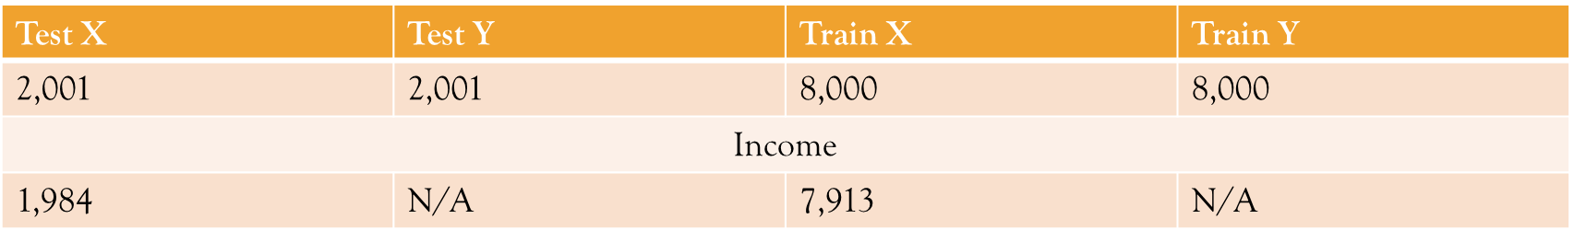
Test/Train Split Data
XGBoost
NN/Linear

Slide 9
Feature Engineering
We aggregated:
total amount spent on different product categories in a month.
total number of visits and total number of purchases made across separate channels (web, catalog, etc.)

Slide 10
One Hot Encoding
Education, Marital Status, Kidhome were encoded to dummy variables using the get_dummies function of pandas.

Slide 11
Normalization Technique
It was not necessary to normalize for XGBoost.
We used the MinMax scaler from Sklearn to normalize the data for Neural networks and linear models.

Slide 12
Observation Exclusions
For XGBoost:
We did not exclude observations with missing income since XGBoost will treat this internally. We tested both methods and the accuracy is not affected.
For Neural Net:
We dropped the date the customer enrolled as there is a recency indicator that gives the days since the customer enrolled.
We dropped missing values of income.

Slide 13
Outlier Treatment
Outliers were not removed for our XGBoost Model
We used the capping method for our Neural Network model.
Values below the bottom 1% and above the top 99% were capped at those values to minimize the impact of extreme observations.
Capping decreased AUC on our logistic regression, so we did non cap for this model.

Slide 14
Missing Value Imputation
For the neural network and logistic regression models, we dropped the observations with missing income.
Since there could be something about a certain income level (high or low) that is correlated with a customer not reporting income, we chose not to impute a value such as an average or minimum to avoid bias.

Slide 15
Summary Stats for Final Data

Slide 16
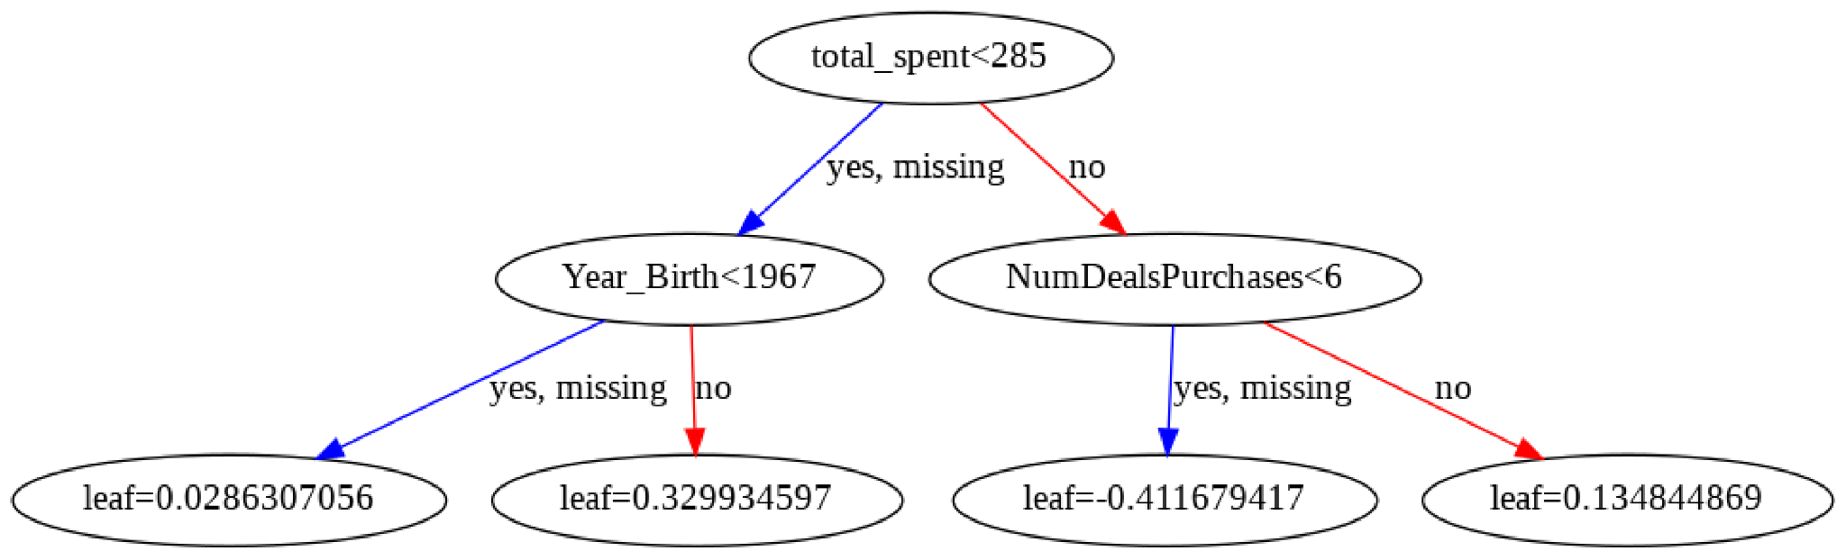
Decision Tree
**utilizing plot_tree() function of XGBoost

Slide 17
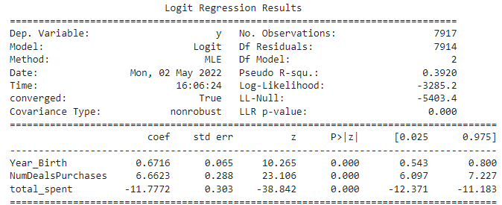
Logistic Regression Model
AUC= .927
**utilizing statsmodels package

Slide 18
XGB Grid Search Code
from pandas import read_csv
from xgboost import XGBClassifier
from sklearn.model_selection import GridSearchCV
from sklearn.model_selection import StratifiedKFold
from sklearn.preprocessing import LabelEncoder
import matplotlib
matplotlib.use('Agg')
from matplotlib import pyplot
import numpy
# grid search
model = XGBClassifier()
n_estimators = [50, 100, 150, 200]
max_depth = [4, 8]
learning_rate=[.01,.1,.25]
print(max_depth)
param_grid = dict(max_depth=max_depth, n_estimators=n_estimators, learning_rate=learning_rate)
kfold = StratifiedKFold(n_splits=10, shuffle=True, random_state=7)
grid_search = GridSearchCV(model, param_grid, scoring="roc_auc", n_jobs=-1, cv=kfold, verbose=1)
grid_result = grid_search.fit(X, y)
# summarize results
print("Best: %f using %s" % (grid_result.best_score_, grid_result.best_params_))
means = grid_result.cv_results_['mean_test_score']
stds = grid_result.cv_results_['std_test_score']
params = grid_result.cv_results_['params']
for mean, stdev, param in zip(means, stds, params):
print("%f (%f) with: %r" % (mean, stdev, param))
# plot results
scores = numpy.array(means).reshape(len(max_depth), len(n_estimators), len(learning_rate))
for i, value in enumerate(max_depth):
pyplot.plot(n_estimators, scores[i], label='depth: ' + str(value))
pyplot.legend()
pyplot.xlabel('n_estimators')
pyplot.ylabel('AUC')
pyplot.savefig('n_estimators_vs_max_depth.png')

Slide 19
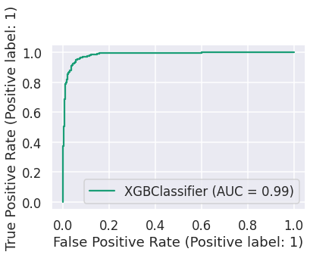

Grid Search Results
Original XGB Model
Post Grid-Search XGB Model

Slide 20
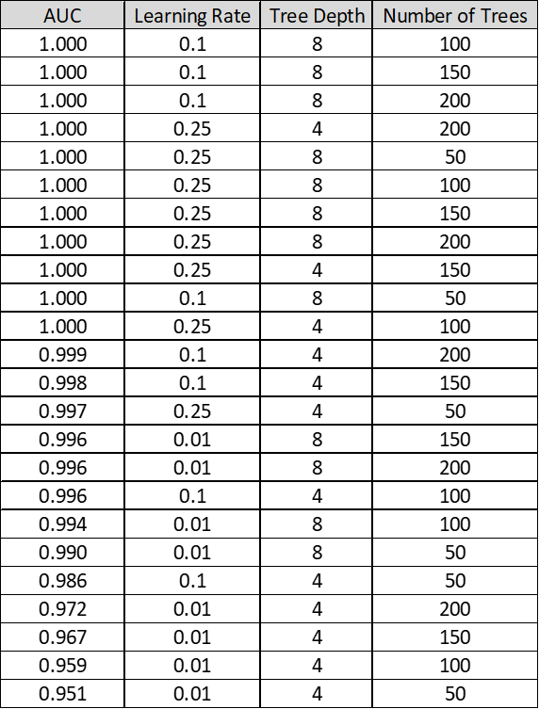
Grid Search Results

Slide 21
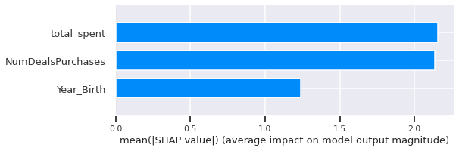
Most Impactful Features
SHAP Summary Plot

Slide 22
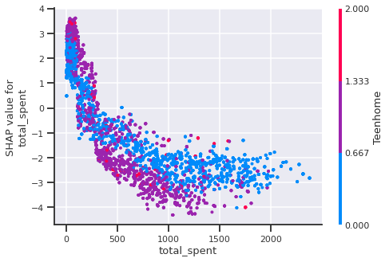
SHAP Analysis Continued
SHAP Dependence Plot for Top 3 Attributes
Total Spent
Shows the marginal dependence Kidhome has on the plotted variable, total spent.
Red/Blue:
Blue indicates values that drive the predicted value lower.
Red indicates values that drive the predicted value higher.

Slide 23
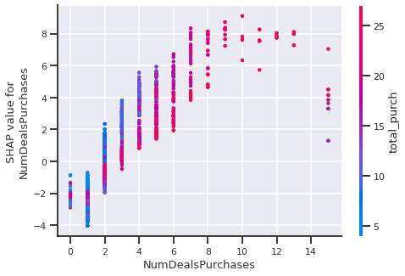
SHAP Analysis Continued
SHAP Dependence Plot for Top 3 Attributes
Number of Deals Purchased

Slide 24
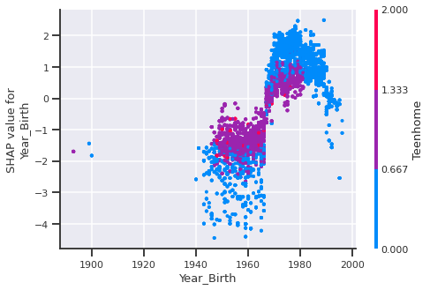
SHAP Analysis Continued
SHAP Dependence Plot for Top 3 Attributes
Year of Birth

Slide 25
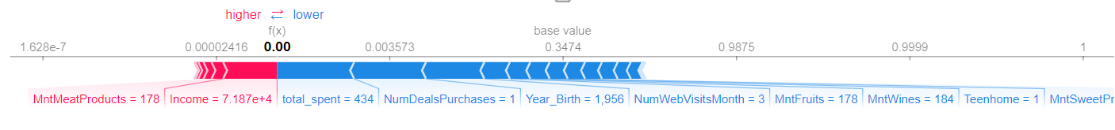
SHAP Analysis Continued
Individual SHAP Value Plot — Local Interpretability

Slide 26
Neural Network Grid Search Code
from sklearn.metrics import roc_auc_score, auc, accuracy_score, confusion_matrix, mean_squared_error, classification_report, confusion_matrix
from keras.wrappers.scikit_learn import KerasClassifier
from sklearn.model_selection import GridSearchCV
import tensorflow as tf
import tensorflow.keras as keras
from tensorflow.python.keras.layers import Input, Dense
from keras.models import Sequential
def create_model(optimizer='adam', units=4, activation = 'relu', hidden_layers=1):
# Initialize the constructor
model = Sequential()
# Add an input layer
model.add(Dense(units, kernel_initializer='uniform', activation=activation))
for i in range(hidden_layers):
# Add one hidden layer
for i in range(units):
model.add(Dense(units=units, activation=activation))
# Add an output layer
model.add(Dense(1, activation='sigmoid'))
#compile model
model.compile(loss='binary_crossentropy', optimizer=optimizer, metrics=[ tf.keras.metrics.AUC()])
return model
model = KerasClassifier(build_fn=create_model, epochs=75, batch_size=15, verbose=1)
# define the grid search parameters
activation = [ 'softplus', 'sigmoid']
units=[5,10]
hidden_layers=[2,5]
#activation=activation,
param_grid = dict(hidden_layers=hidden_layers, units=units, activation=activation)
grid = GridSearchCV(estimator=model, param_grid=param_grid,scoring='roc_auc', n_jobs=-1, cv=3)
grid_result = grid.fit(X_train_normalized, y_train)
print("Best: %f using %s" % (grid_result.best_score_, grid_result.best_params_))
means = grid_result.cv_results_['mean_test_score']
stds = grid_result.cv_results_['std_test_score']
params = grid_result.cv_results_['params']
for mean, stdev, param in zip(means, stds, params):
print("%f (%f) with: %r" % (mean, stdev, param))

Slide 27
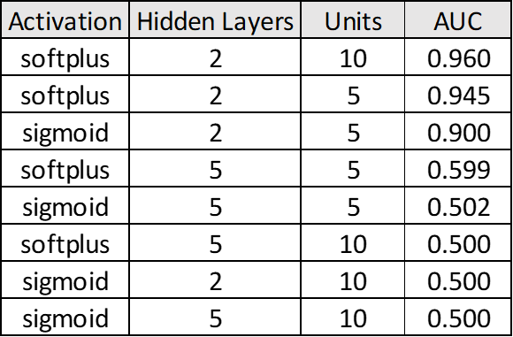
Neural Network Grid Search Results

Slide 28
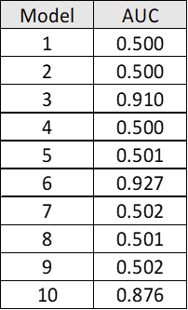
Neural Network 10 Fold CV

Slide 29
Strategy Results Summary
Model Output: Binary (0,1) using default probability thresholds
1=Child in Household
0=No child in household
XGBoost Model had the highest AUC- improved with grid search from .947 to .999.
This model will help us accurately predict almost all of the households with children and allow our coupon campaign to increase revenue by With an AUC of .999, we can predict that our coupon campaign will increase revenue by 3,968€.

